Slide 1
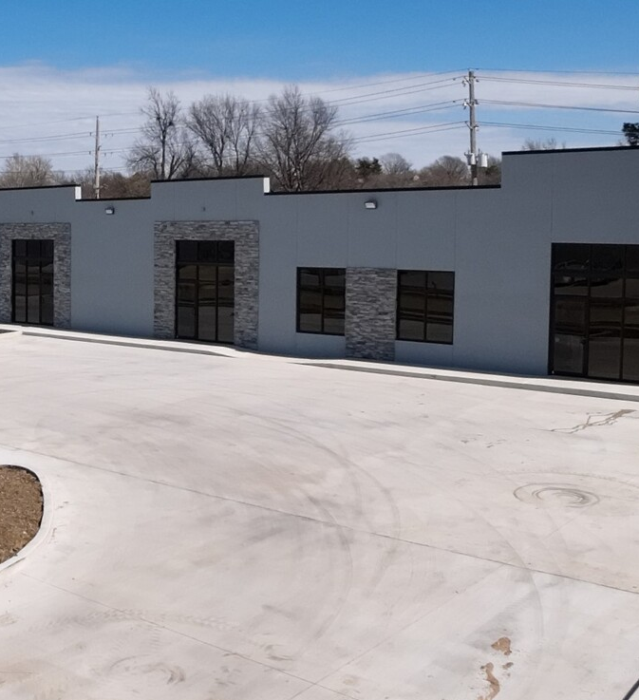
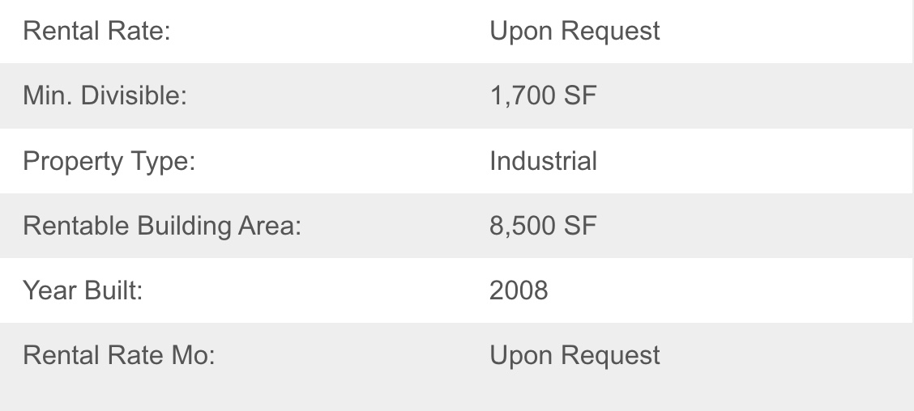
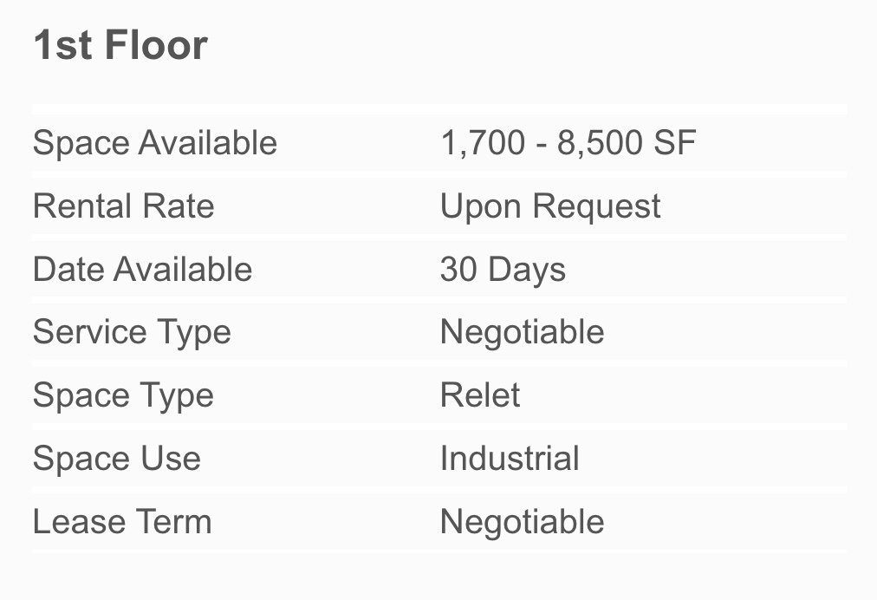
1101 N Birch Ave
Broken Arrow
1225 N Birch Ave, Broken Arrow, OK 74012
Type : 3 Star Office
Location : Suburban
14,500 SF
Class B
Construction Steel
Year Built 2022
$17 - 21/fs (Office)

Slide 2
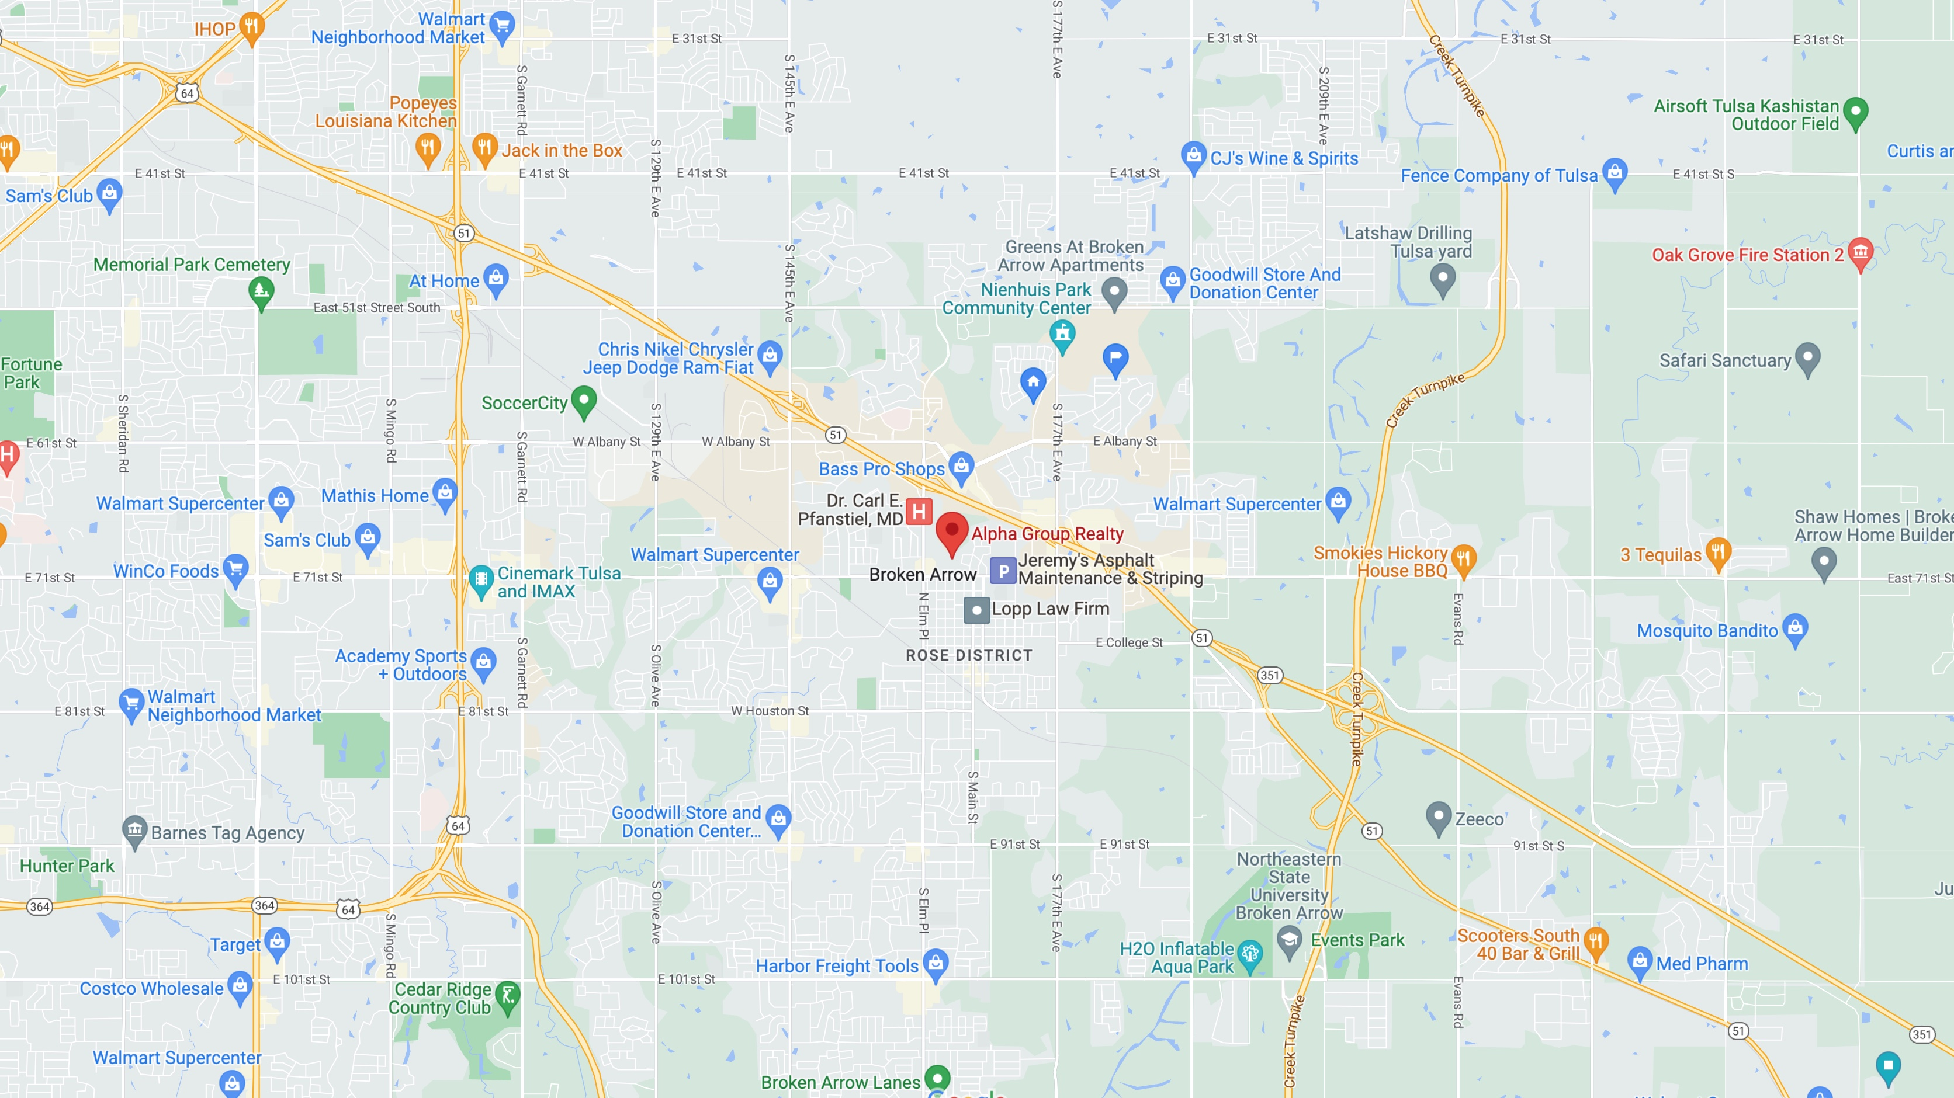

Slide 3
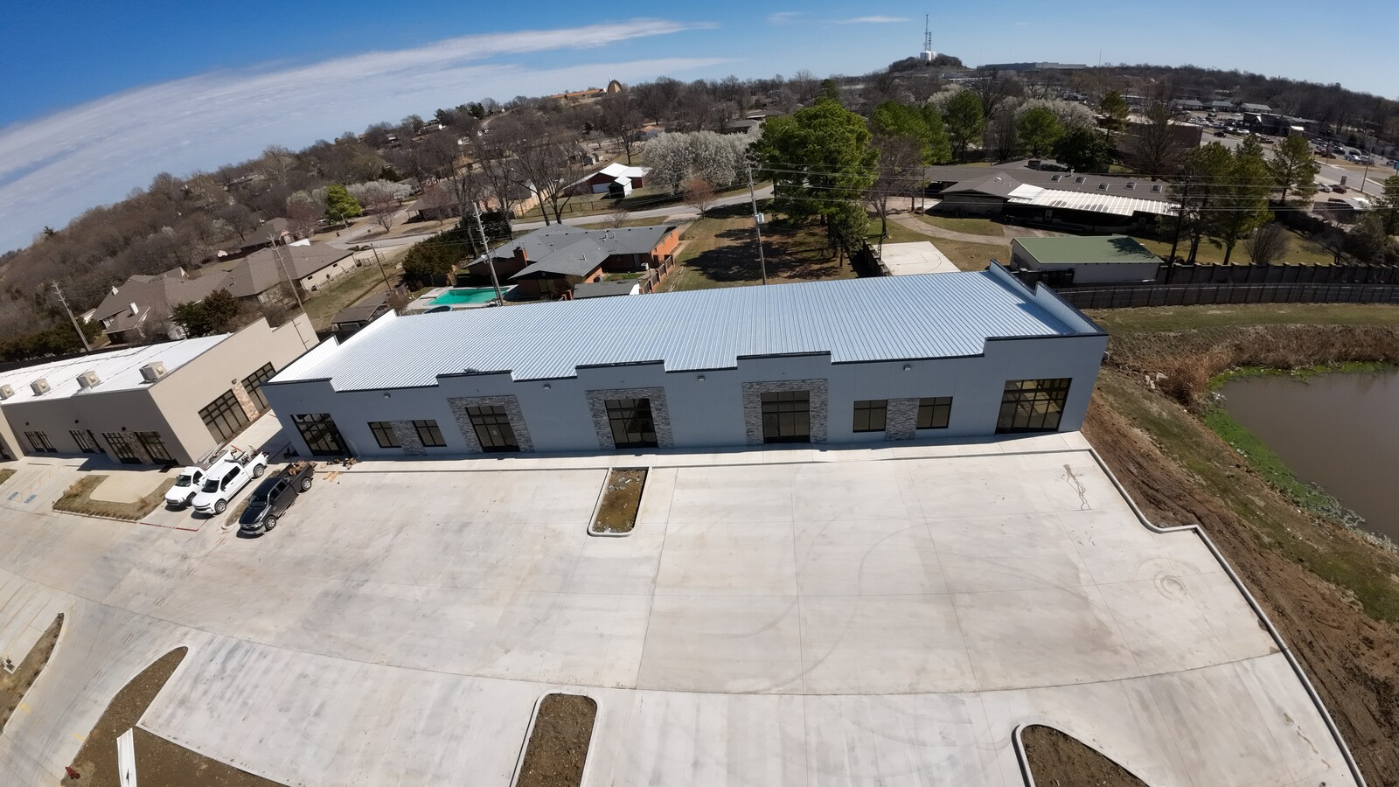

Slide 4
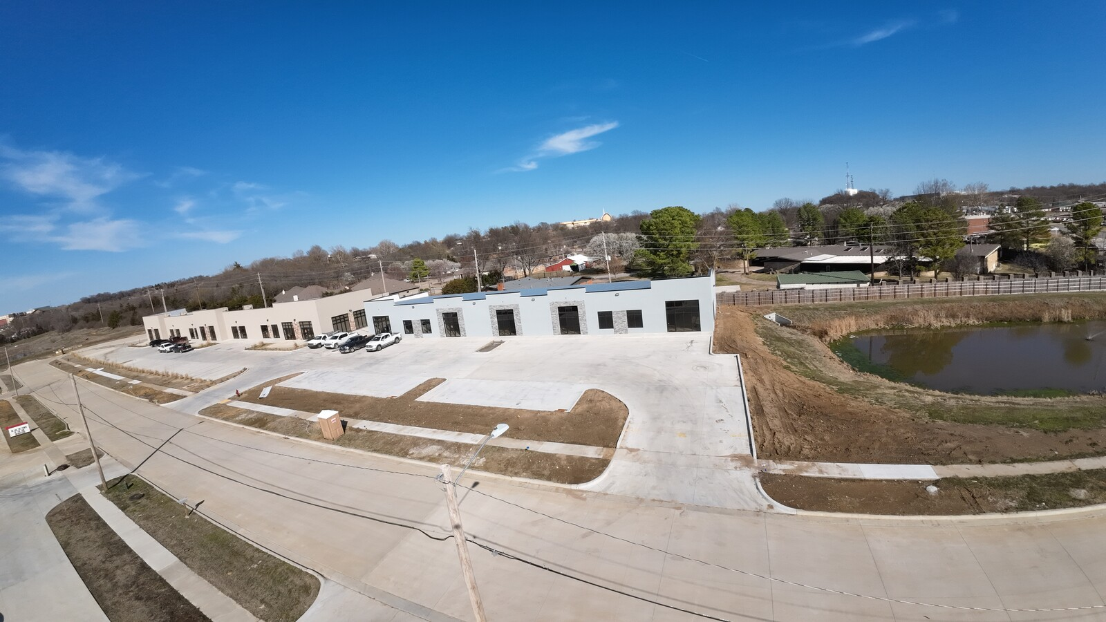

Slide 5
