Slide 1
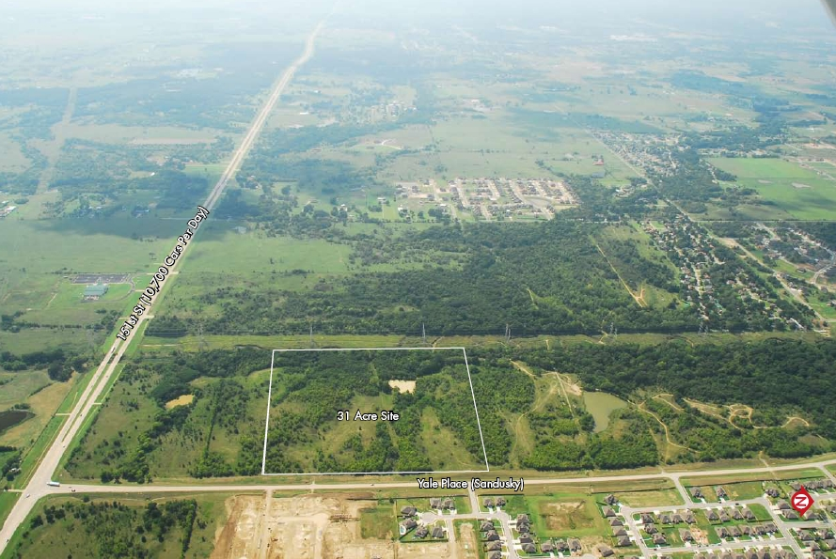
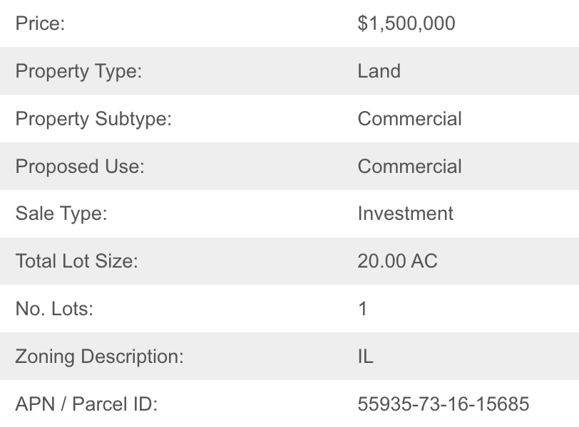
Kimberly Clark Sites- Parcel A
14700 S Yale Pl, Bixby, OK 74008

Slide 2
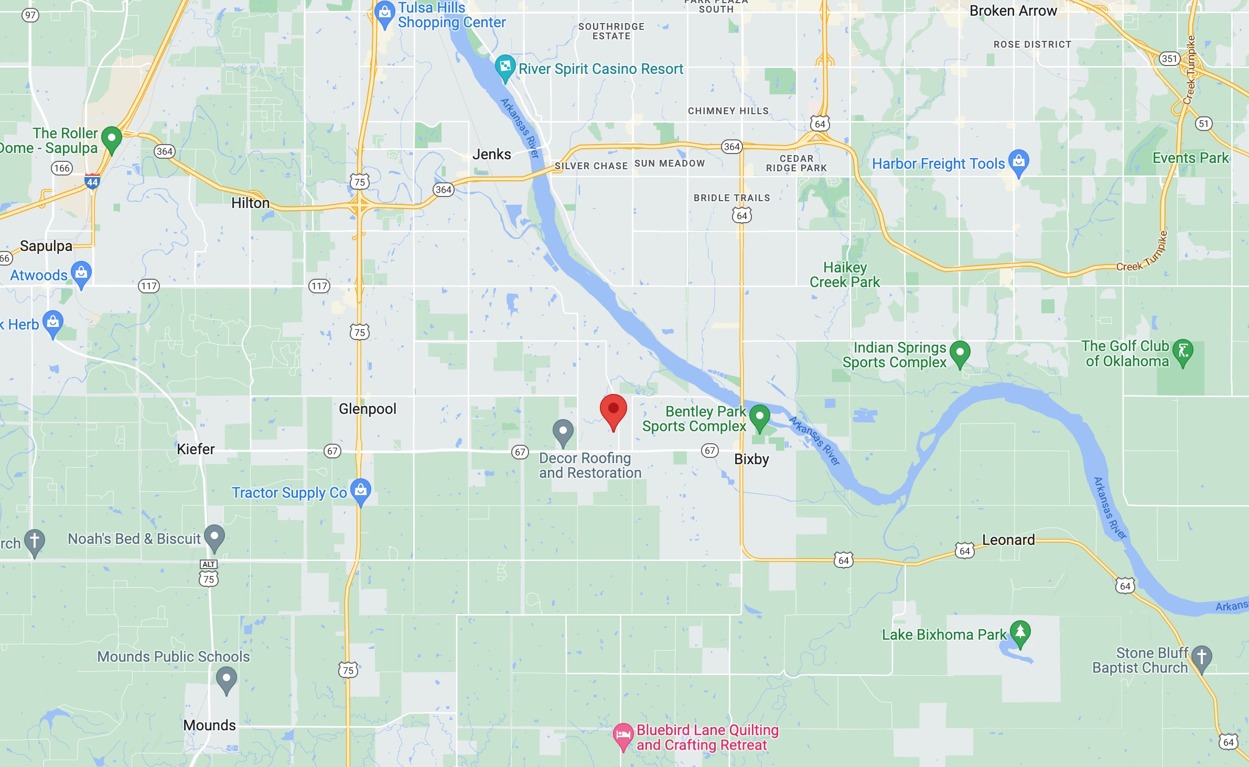

Slide 3
